Slide 1
THE PRESIDENT OF INDIA

Slide 2
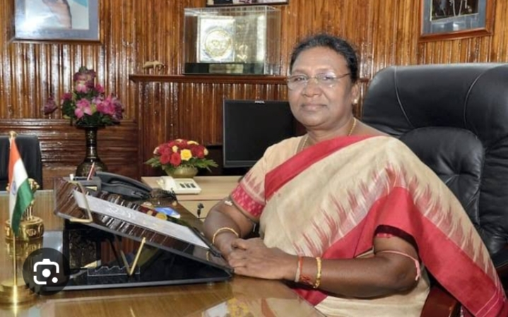
INTRODUCTION TO OFFICE OF PRESIDENT
The Indian president is the head of the state and he is also called the first citizen of India. The president is the nominal head of executive. He is a part of union executive, provision of article 52 -78.Droupdi Murmu is15th current president of India since 2022

Slide 3
COMPOSITION OF PRESIDENT
Qualification of president
Tenure of the president
Vacation of the office of the president
Salary and allowances of the president
Privileges of the president

Slide 4
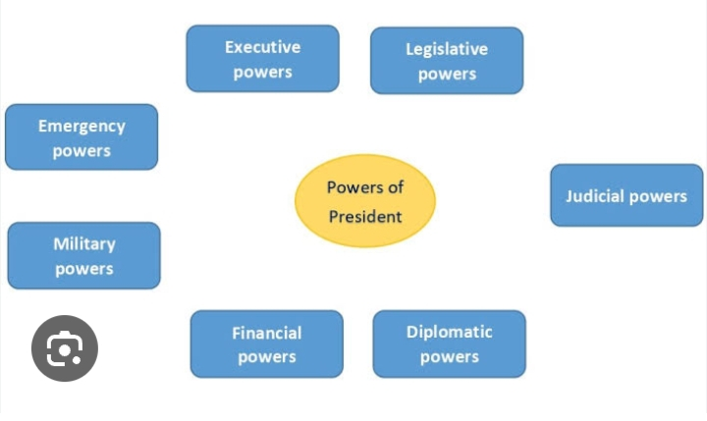
POWER AND FUNCTIONS OF THE PRESIDENT

Slide 5
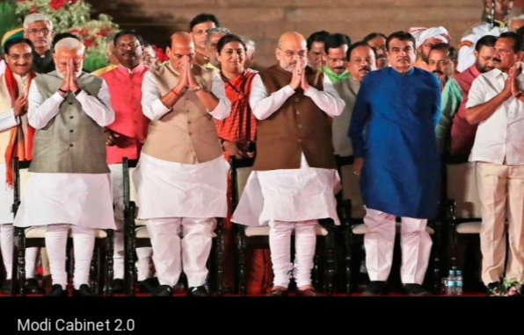
EXECUTIVE POWER OF THE PRESIDENT
Powers related to council of ministers
Military power
Control over appointments
Appointment of different commissions
Administrative functions

Slide 6
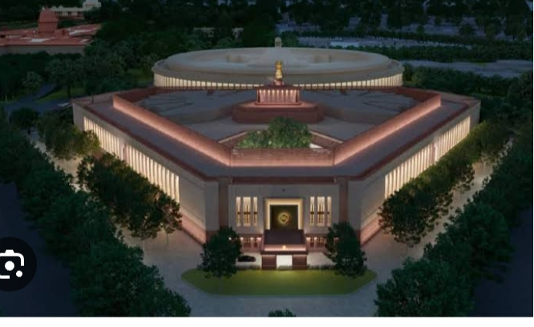
LEGISLATIVE POWERS OF THE PRESIDENT
To convene and prorogue the session of the parliament
To inaugurate the parliament
To address and send the message to the parliament
To convene the joint meeting of both the houses
To dissolve the house of the people
Power to issue ordinance

Slide 7
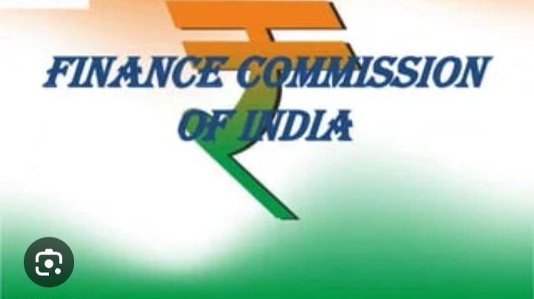
FINANCIAL FUNCTIONS OF THE PRESIDENT
To get the money Bill introduce
Control over contingency fund
Appointment of finance commission
Distribution of export duty on jute
To place the report of comptroller and auditor general before the parliament

Slide 8
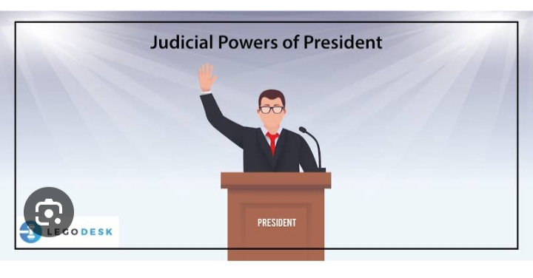
JUDICIAL POWER OF THE PRESIDENT
President can appoint judges, can pardon a criminal or reduce the punishment or suspend it. They also can pardon a person convicted by court martial.

Slide 9
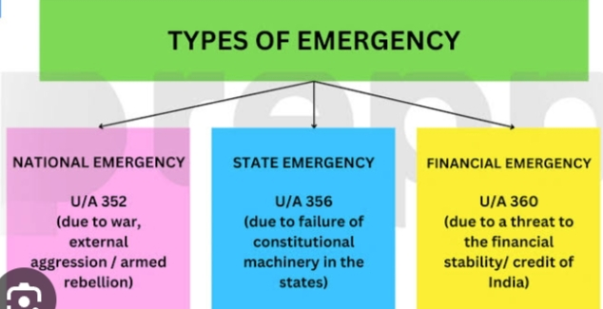
EMERGENCY POWER OF THE PRESIDENT
There are three types of emergency Power of Indian president. These are as follows:-

Slide 10
DISCRETIONARY POWERS OF THE PRESIDENT
The discretionary power of the Indian president are not explicity mentioned in the Indian constitution, but cases where the Indian president do not act on the advice of CoM. The case of discretionary power are as follows:-
Suspensive veto
Pocket veto
President can seek information from Prime Minister
Case of no sitting of both houses
Cade of no majority.

Slide 11
POSITION OF THE INDIAN PRESIDENT
The president is the supreme commander of the Indian Armed forces. Only the president can declare war or conclude peace, on the advice of ministers headed by Prime Minister. All important treatises and contract are made in the President’s name .

Slide 12
THANK YOU

